Slide 1
PARALLEL DATABASE
Name : Ranga Swamy Goud
Roll No: 17BCS010
Under the supervision of Dr Uma S

Slide 2
What is parallel database system?
A parallel database system seeks to improve performance through parallelization of various operations, such as loading data, building indexes and evaluating queries. ... Parallel databases improve processing and input/output speeds by using multiple CPUs and disks in parallel.

Slide 3
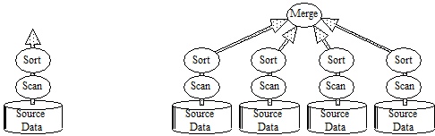

Slide 4
pipeline parallelism partitioned data allows partitioned parallelism
The dataflow approach to relational operators gives both pipelined and partitioned parallelism. Relational data operators take relations (uniform sets of records) as input and produce relations as outputs. This allows them to be composed into dataflow graphs that allow pipeline parallelism (left) in which the computation of one operator proceeds in parallel with another, and partitioned parallelism in which operators (sort and scan in the diagram at the right) are replicated for each data source, and the replicas execute in parallel.

Slide 5
Basic Techniques for Parallel Database Machine Implementation
Parallelism Goals and Metrics:
The ideal parallel system demonstrates two key properties:-
(1) linear speedup.
(2) linear scaleup.

Slide 6
(1) linear speedup: Twice as much hardware can perform the task in half the elapsed time.
(2) linear scaleup: Twice as much hardware can perform twice as large a task in the same elapsed time .

Slide 7
Hardware Architecture, the Trend to Shared-Nothing Machines
The ideal database machine would have a single infinitely fast processor with an infinite memory with infinite bandwidth — and it would be infinitely cheap (free).
Given such a machine, there would be no need for speedup, scaleup, or parallelism.
. Technology is promising to deliver fast one-chip processors, fast high-capacity disks, and high-capacity electronic RAM memories.
It also promises that each of these devices will be very inexpensive by today's standards, costing only hundreds of dollars each.

Slide 8
How can we build scaleable multi-processor systems?
Large-scale;-multiprocessor systems have long held the promise of substantially
higher performance than traditional uniprocessor systems.
However, due to a number of difficult problems, the potential of these machines
has been difficult to realize.
Given such results, database machine designers see little justification for the hardware and
software complexity associated with shared-memory and shared-disk designs.
Stonebraker suggested the following simple taxonomy for the spectrum of designs

Slide 9
shared-memory: All processors share direct access to a common global memory and to all disks. The IBM/370, and Digital VAX, and Sequent Symmetry multi-processors typify this design.
shared-disks: Each processor has a private memory but has direct access to all disks. The IBM Sysplex and original Digital VAXcluster typify this design.
shared-nothing: Each memory and disk is owned by some processor that acts as a server for that data. Mass storage in such an architecture is distributed among the processors by connecting one or more disks. The Teradata, Tandem, and nCUBE machines typify this design.

Slide 10
The basic shared-nothing design.
Each processor has a private memory and one or more disks. Processors communicate via a high-speed interconnect network.

Slide 11
The shared-memory and shared-disk designs
A shared-memory multi-processor connects all processors to a globally shared memory.
Shared-disk systems give each processor a private memory, but all the processors can directly address all the disks.

Slide 12
Shared-memory and shared-disk systems do not scale well on database applications.
The interconnection network must have the bandwidth of the sum of the processors and disks.
It is difficult to build such networks that can scale to thousands of nodes.
To reduce network traffic and to minimize latency, each processor is given a large private cache.

Slide 13
A Parallel Dataflow Approach to SQL Software?
The parallel dataflow works by partitioning and merging data streams into these sequential ports.
This approach allows the use of existing sequential relational operators to execute in parallel.
Consider a scan of a relation, A, that has been partitioned across three disks into fragments A0, A1, and A2.

Slide 14
Terabyte online databases, consisting of billions of records, are becoming common as the price of online storage decreases.
These databases are often represented and manipulated using the SQL relational model.
The next few paragraphs give a rudimentary introduction to relational model concepts needed to understand the rest of this paper.

Slide 15
. Expressed in SQL, a scan of a telephone book relation to find the phone numbers of all people named Smith would be written:
SELECT telephone_number /* the output attribute(s) */
FROM telephone_book /* the input relation */
WHERE last_name = 'Smith'; /* the predicate */
A scan's output stream can be sent to another relational operator, returned to an application, displayed on a terminal, or printed in a report.

Slide 16
The output of a scan may be sent to a sort operator that will reorder the tuples based on an attribute sort criteria, optionally eliminating duplicates.
SQL defines several aggregate operators to summarize attributes into a single value.
for example
taking the sum, min, or max of an attribute, or counting the number of distinct values of the attribute

Slide 17
The SQL data model was originally proposed to improve programmer productivity by offering a non-procedural database language
. Data independence was an additional benefit; since the programs do not specify how the query is to be executed, SQL programs continue to operate as the logical and physical database schema evolves.

Slide 18
The State of the Art
Teradata
Teradata quietly pioneered many of the ideas presented here.
Since 1978 they have been building shared-nothing highly-parallel SQL systems based on commodity microprocessors, disks, and memories.
Teradata systems act as SQL servers to client programs operating on conventional computers.

Slide 19
Teradata – Architecture
Teradata architecture is a Massively Parallel Processing Architecture.
Three important components of Teradata are:
Parsing Engine
BYNET
Access Module Processors (AMPs).

Slide 20
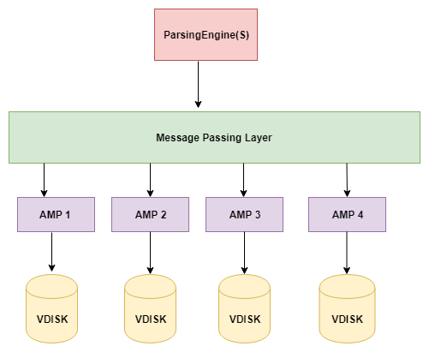
Teradata Architecture Diagram

Slide 21
Thanks…

